Slide 1
A Study on Influence Maximization Problem in Social Network
Souvik Saha Soumyajit Bhattacharyya
T91/IT/154004 T91/CSE/156001
D01-1121-0171-15 A03-1112-0120-13
Pratik Mukherjee
T91/CSE/154013
D01-1121-0127-15
Submitted by:

Slide 2

MOTIVATION:
A new product is to be launched. The production team plans about marketing it among the public. Broadcasting the information or distributing free samples is the basic approach.
Can we improve the sales with the help of social network?
How to identify targets from the population and invest minimum resource and get maximum benefit?

Slide 3
EXAMPLES:
A new book is launched. The publisher gives out specimen copies to the teachers. Still the sales didn’t go up. They thought to invest further. The idea is minimum investment maximum return. They thought to give free books to students. But how to identify those students?
They target the class representatives as they are well known to all other students. Their book review can improve the sales.
The same idea is extended to social networks.
Identifying influential nodes allows us to better control epidemic outbreaks, accelerate information propagation, and conduct successful e-commerce advertisements, and so on.

Slide 4
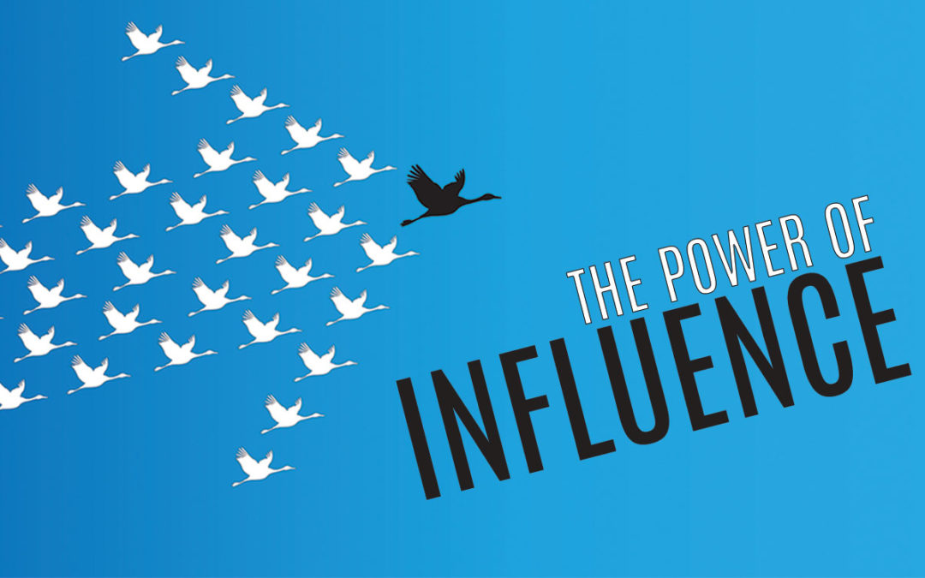
How to track down the social groups who are spreading misleading posts in social media and the agitating the public in large scale thus affecting the harmony of the society?
Backtracking from the influenced people we can find such groups and block them immediately. Facebook has been constantly working with such algorithms to maintain peace in the society.
These reasons motivates us to study the influence maximization techniques.

Slide 5
SOCIAL NETWORK MODELLING:
Social Network is modelled as a graph G=(V,E) where V is set of nodes and E is set of edges.
Nodes are people and the edges are social relationships.
For directed edges : Eg. Twitter (following-follower relation)
For undirected edges : Eg. Facebook (friendship relation)
Not all nodes or edges are similarly influential
There are several node or edge measure to Indicate the influential strength.

Slide 6
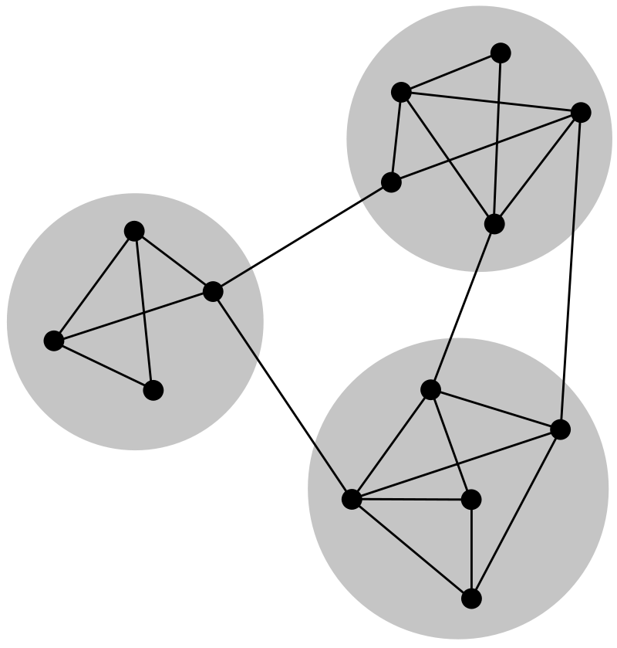
Community
Property: More intra edges than inter edges
Two types of communities
Disjoint Community
Overlapping Community
Intra Edges
Inter Edges

Slide 7
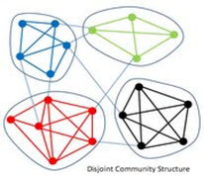
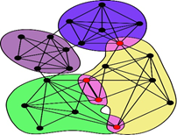
Disjoint Community
Crisp Assignment
Anode can belong to only one community
Overlapping Community
Fuzzy Assignment
A node can belong to one or more than one community

Slide 8
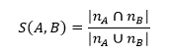
Edge Measures
A. Tie Strength - Depending on number of overlapping friends/neighbours there are two types
Strong Tie
Overlap is high
Close friends and family
Weak Tie
Overlap is small
Part of other social circle
When there is no overlap, the connection A-B is a local bridge.

Slide 9
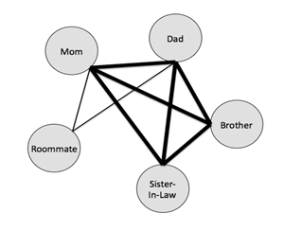
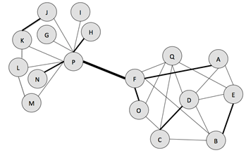
EXAMPLES:
Strong Tie
Weak Tie/Bridge

Slide 10
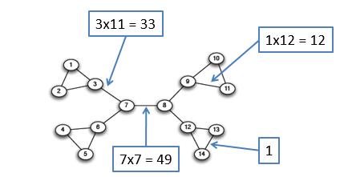
B. Edge Betweenness
The edge betweenness centrality value for edge (a, b) is computed from the number of pairs of nodes x and y such that the edge (a, b) lies on the shortest path between x and y.

Slide 11
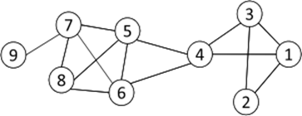
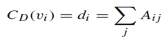
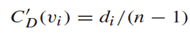
NODE MEASURES
A. Degree Centrality
The importance of a node is determined by the number of nodes adjacent to it.. Let A be the adjacency matrix of a network, and d_{i} be the degree of node i.
Degree Centrality
Normalized Degree Centrality
For node 1, degree centrality is 3; Normalized degree centrality is 3/ (9-1) =3/8.

Slide 12
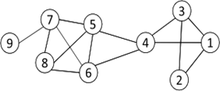
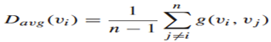
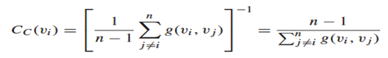
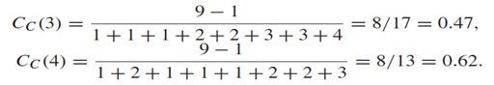
B. Closeness Centrality
How quickly a node can access other nodes
Computed inversing the measure of average distance
Average distance
Closeness Centrality

Slide 13
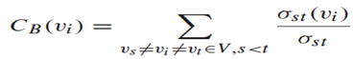
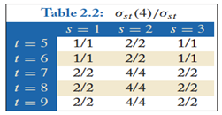
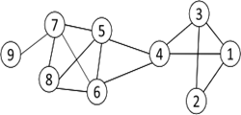
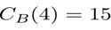
C. Betweenness Centrality
Node betweenness centrality counts the number of shortest paths that pass one node.

Slide 14
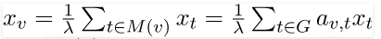
D. Eigenvector Centrality
Here importance of a node is determined by friends of it. If A has many important friends, one should be important as well.
Top Eigenvalue
Normalized Eigen Vector

Slide 15
PROBLEM STATEMENT
Given a undirected and edge-weighted social graph G = (V, E, p), a diffusion model m, and an integer k ≤ |V|, find a set S ⊆ V, |S| = k, such that the expected influence spread σ_{m} (S) is maximum.
Active node : Influenced nodes are active node otherwise it is inactive
Seed set 𝑺 : Initial set of nodes selected to start the diffusion
Influence spread 𝝈 (𝑺) : Expected number of active nodes at the end of diffusion process, if set S is the initial active set.

Slide 16
The solution approach of the taken problem may be conceptualized as a collection of the following three steps:
Finding disjoint communities within a given network.
After the communities are formed the next task is to find seed nodes set from every community depending on the size of the community using well known metrics and modified algorithm (compath).
Finally, the independent cascade model is used to spread the influence throughout the network.

Slide 17
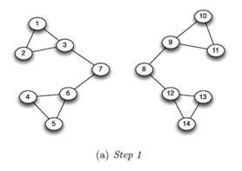
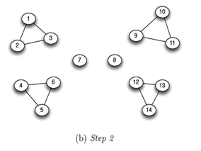
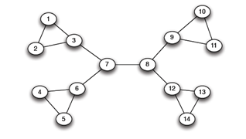
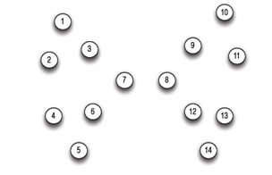
Girvan Newman Algorithm
i. The betweenness of all existing edges in the network is calculated first.
ii. The edge with the highest betweenness is removed.
iii. The betweenness of all edges affected by the removal is recalculated.
iv. Steps ii and iii are repeated until no edges remain.
(c) Step 3

Slide 18
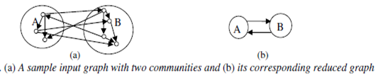
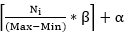
COMPATH Algorithm
Step 1: Compute New_Network
Community detection performed. Network is divided into smaller components.
Step 2: Compute Selected_Nodes
After choosing important communities, some representative nodes should be selected from each of them having higher Closeness centrality.
The number of nodes which should be selected from each community depends on the formula
At last the representative nodes selected from each community is merged to form seed set

Slide 19
Working of compath:
1
2
7
8
3
6
5
4
9
Inactive
10
Active
11
12

Slide 20
Final outcome:
1
2
7
8
3
6
6
4
9
5
4
5
10
11
11
12
12

Slide 21
Small Prototype to understand the process of influence spreading (Cascade model)
Consider the graph.Here all nodes have idea B. Now we infect B₂ and B₄ with idea A initially. We choose them due to their high degree centrality.
B₃ B₄ B₅
B₂ B₁
B₃ B₄(A) B₅
B₂(A) B₁
Shown graph is a friendship network.
There are two ideas:
A. To go out for movie (payoff/ willingness=20)
B. To study in library (by default everyone’s state) (payoff=10)
Which nodes we should select and infect them with the idea A initially such that it then influences others? We also make sure these seed nodes are the least in number making maximum impact.

Slide 22
For 1st iteration we check all the nodes of the graph if they accept the idea of A.
B₁ ==> No. Of neighbours having idea A= 1 => 1* payoff=1*20=20.
B₁ ==> No. Of neighbours having idea B= 0 => 0* payoff=0*10=0.
Therefore B₁ accepts idea A as 20>=0.
B₂ ==> No. Of neighbours having idea A= 2 => 2* payoff=2*20=40.
B₂ ==> No. Of neighbours having idea B= 1 => 1* payoff=1*10=10.
Therefore B₂ accepts idea A as 40>=10.
B₃ ==> No. Of neighbours having idea A= 2=> 2* payoff=2*20=40.
B₃==> No. Of neighbours having idea B= 0 => 0* payoff=0*10=0.
Therefore B₃ accepts idea A as 40>=0.
B₄ ==> No. Of neighbours having idea A= 2 => 2* payoff=2*20=40.
B₄ ==> No. Of neighbours having idea B= 1 => 1* payoff=1*10=10.
Therefore B₄ accepts idea A as 20>=0.
B₅ ==> No. Of neighbours having idea A= 1 => 1* payoff=1*20=20.
B₅ ==> No. Of neighbours having idea B= 0 => 0* payoff=0*10=0.
Therefore B₅ accepts idea A as 20>=0.
Hence, we see the cascade is complete as all the nodes accepted the idea A

Slide 23
EXPERIMENT AND RESULTS:
Assumptions
1. The network is static network with no incoming or leaving nodes in the network.
2. The influence spread mechanism is considered to be spreading only on the basis of neighbours being active or inactive.
3. The payoff is a measure which is assigned to every node and change according to the number of neighbours having accepted the idea or rejected the idea.
4. The nodes initially chosen as seed nodes remain active till the acceptance payoff becomes less than rejection payoff.

Slide 24
Assumptions (contd.)
5. The algorithm helps to find the smallest set of seed nodes which maximize the influence via cascading which may not be the case in general social network where other attributes play a role in having a positive or negative impact.
6. No sentiment analysis or other psychological behaviour of a node is taken into consideration. These has been summarized to the simple single metric of payoff.
7. Dynamic network or frequent topology change of general social network is not considered. Here it is a snapshot of the social network at a single time instant.

Slide 25
Datasets
Two real networks are used in our experiments:
I. The first dataset is a small static dataset of 100 nodes having non-overlapping communities having the edge list in a csv file with given weights and connectedness.
II. This static dataset consists of ‘circles’ (or ‘friends lists’) from Facebook. Facebook data was collected from survey participants using this Facebook app. The dataset includes node features (profiles), circles, and ego networks. It has highly overlapping communities.

Slide 26
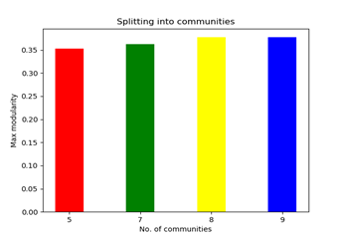
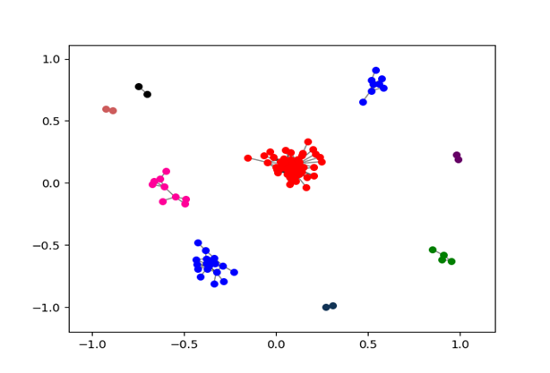
Experiments on Dataset-1
First the total communities are detected from the total network using Girvan Newman algorithm.
The graph shows the community formation till the modularity value increases.
This graph shows that after 8 communities are formed the value is stagnant. So, iteration stops after max modularity does not increase from 0.372 for 8 communities as well for 9 communities.

Slide 27
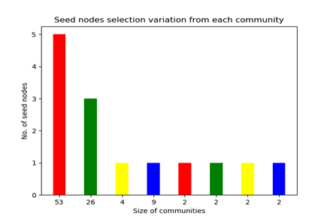
After community detection the size of seed node set from every community is calculated according to the size of the community itself.

Slide 28
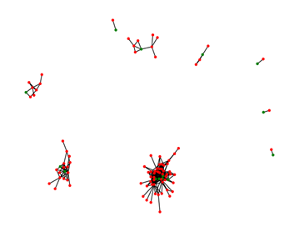
Then these 14 nodes are selected as the total seed nodes, on the basis of higher closeness centrality, which are to be made active initially to start influencing the total network.
The initial network structure where 14nodes out of 100 nodes are active.

Slide 29
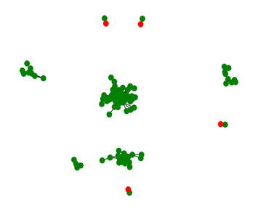
After the selection is done the cascading model starts and the influence spreads throughout the network as shown below.
The final structure of the network where 96 nodes are active.

Slide 30
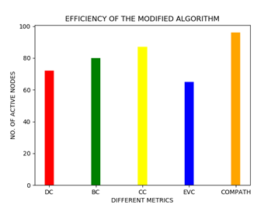
Hence from the results obtained it can be concluded that the compath algorithm it a much better algorithm to find the minimum seed nodes to spread maximum influence in the network. The number of active nodes is the highest for the ‘compath’ algorithm.
For 2 iterations of cascades the resulting active node count out of the total 100 nodes :
CENTRALITY USED | NO. OF ACTIVE NODES
BETWEENNESS | 80
DEGREE | 70
CLOSENESS | 87
EIGEN-VECTOR | 62
COMPATH | 96

Slide 31
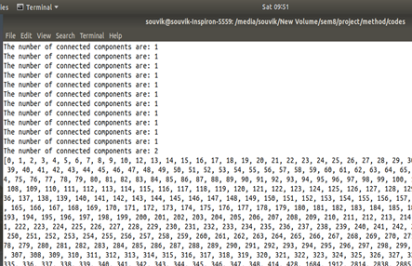
Experiments on Dataset-2
For the Facebook dataset we have 4000+ nodes where only the edge list is given. Applying the modified algorithm of ‘compath’ to maximize the influence within the network more effectively. But the outcome is not significant as there are many overlapping communities. So after long execution time the following output is obtained.
In this output it can be concluded that after many iterations the node having highest betweenness centrality gets separated into a different community. But all other nodes are so densely connected within the network that no more communities can be found. So due to this reason the ‘compath’ algorithm cannot work properly on huge network like this having overlapping communities.

Slide 32
The basic metrics are used in the dataset-2 and they are compared among themselves to check their efficiency.
Initially 20 nodes are selected from the graph having the highest metric values, then we give the idea A to them so that they influence the other nodes to the maximum.
Here as the graph size is huge the iterations may be huge to complete the cascade. So, for our purpose we restrict it to 100 iterations only.
We select 20 influential nodes using four metrics and run the code four times and then compare them to find out which metric rightly predict the most influential nodes in this graph.

Slide 33
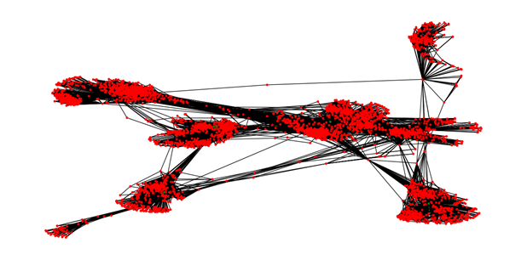
The initial state of the network of 4000+ nodes where all nodes remain inactive and no influence cascading has started.

Slide 34
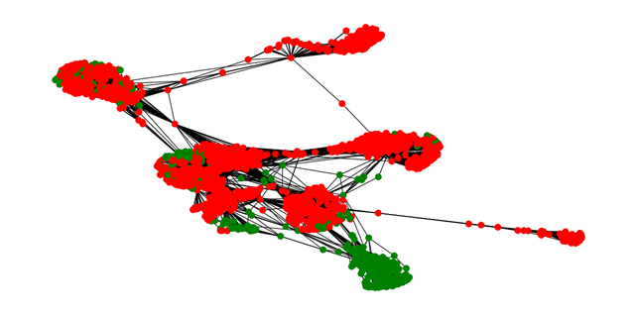
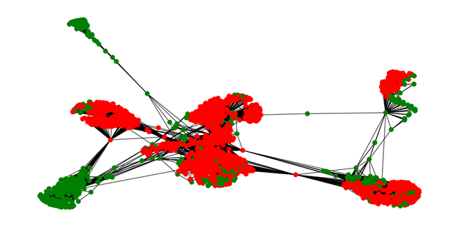
The state of the network after 20 initial nodes having highest Degree and Betweenness Centrality are made active and influence spread for 100 iterations.
Degree Centrality
Betweenness Centrality

Slide 35
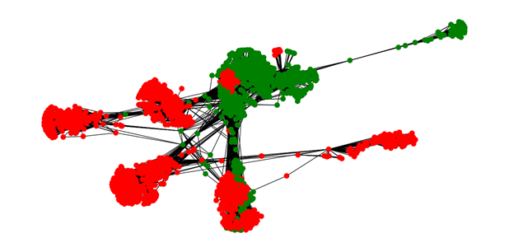
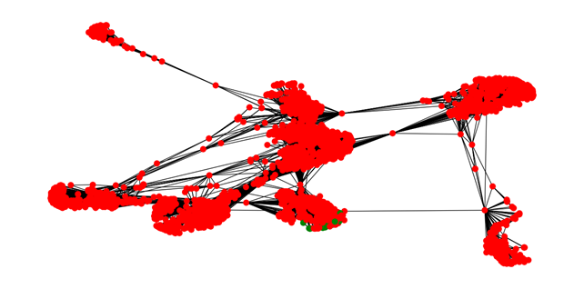
The state of the network after 20 initial nodes having highest Degree and Betweenness Centrality are made active and influence spread for 100 iterations.
Closeness Centrality
Eigenvector Centrality

Slide 36
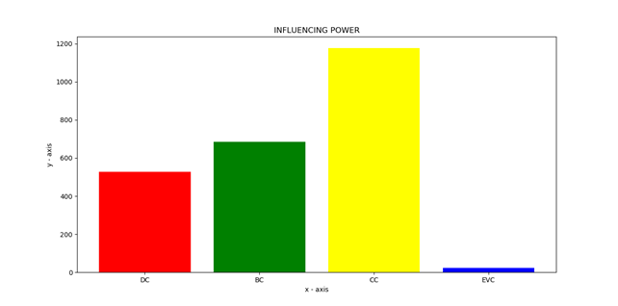
Now we compare all four metrics by plotting a graph of the total active nodes after 100 iterations as shown above.
Hence, we conclude that the closeness centrality is more important metric to predict the influential nodes in the graph. Thus, closeness centrality is considered for further experiments

Slide 37
Here we can vary the two most important parameters of the algorithm for improving the count of active nodes in the network. These are as follows:
1. To increase the number of selected seed nodes.
2. To increase the number of iterations and persisting the continuous influence spread.
This method is applied to the same network with changing parameter values and noticing improvement in the model. We stop if the result starts degrading.
The table shows the variations in the increase and decrease of the active nodes in the network for certain parametric values: a) For 50 iterations the resulting active node count out of the total 4000+ nodes:
Centrality used | 20 seed nodes | 30 seed nodes | 40 seed nodes
Degree | 527 | 527 | 527
Betweenness | 604 | 624 | 698
Closeness | 872 | 1052 | 1052
Eigenvector | 22 | 425 | 332

Slide 38
b) For 100 iterations the resulting active node count out of the total 4000+ nodes:
Centrality used | 20 seed nodes | 30 seed nodes | 40 seed nodes
Degree | 527 | 527 | 527
Betweenness | 685 | 704 | 685
Closeness | 1177 | 1538 | 1524
Eigenvector | 22 | 756 | 659
Result: Hence it is noted that the best result is obtained if we take 30 seed nodes and iterate the influence loop for 100 times. There may be some improvement for other values, but due to limited computation capacity we accept this result.

Slide 39
CONCLUSIONS:
In this project, an efficient algorithm, named ComPath, was used on the cascade model to find top-k most influential people in social networks.
The algorithm detects the communities of the input network at first and investigates a limited number of them to reduce the execution time. Also, ComPath is able to suggest a limited number of communities to be investigated from the input network. The method implemented in the project is not effective for highly overlapping networks which is a concern for future improvement.
Perfect influence maximization model may be difficult to develop as the networks in real life is dynamic, and the influential probability changes with the change in one's thought process. Also, the monotonicity of a node is very hard to assure in real life scenario. Improved version of the algorithm can be obtained with more efficient greedy algorithms.

Slide 40
REFERENCES:
[1] Kanna Al Falahi, Yacine Atif, Ajith Abraham, “Models of Influence in Online Social
Networks”, International Journal Of Intelligent Systems, Vol. 29, pg- 161–183 (2014), Faculty of Information Technology, UAE University, Al Ain, United Arab Emirates, VSB-Technical University of Ostrava, Ostrava, Czech Republic.
[2] Jaewon Yang, EE Department, Stanford University, Jure Leskovec, “Modelling
Information Diffusion in Implicit Networks “, CS Department, Stanford University. (2010)
[3] Sinan Aral and Paramveer S. Dhillon, “Social influence maximization under empirical influence models” (2018), https://doi.org/10.1038/s41562-018-0346-z
[4] Ding-Zhu Du, “Influence Maximization”, Issue No. 01 - Feb. (2017 vol. 25), University of Texas at Dallas. Pp- 112-125 http://doi.ieeecomputersociety.org/10.1109/TNET.2016.2563397

Slide 41
[5] Chen, W., Wang, Y., & Yang, S. (2009). Efficient influence maximization in social networks. Paper presented at the 15th ACM SIGKDD International Conference on Knowledge Discovery and Data Mining, Paris, France.
[6] Goyal, A., Lu, W., & Lakshmanan, L. V. S. (2011b). SIMPATH: An efficient algorithm for influence maximization under the Linear Threshold Model. Paper presented at the the 2011 IEEE 11th International Conference on Data Mining.
[7] Wang, Y., Cong, G., Song, G., &Xie, K. (2010). Community-based greedy algorithm for mining top-K influential nodes in mobile social networks. Paper presented at the 16th ACM SIGKDD International Conference on Knowledge Discovery and Data Mining, Washington, DC, USA.
[8] Rahimkhani, K., Aleahmad, A., Rahgozar, M., Moeini, A., A Fast Algorithm for Finding Most Influential People Based on the Linear Threshold Model, Expert Systems with Applications (2014), doi: http://dx.doi.org/10.1016/j.eswa.2014.09.037

Slide 42
THANK YOU

